Slide 1
Prediction of Individual Brain Ages from MRI Data Sets using Deep Learning
Lv Ruyi 3035142560
Supervisors:
Prof. Ed X. Wu
Dr. Edward S. Hui

Slide 2
Contents
Background
Methodology
Result
Future Directions
Conclusion

Slide 3

Background
1. Clinical Needs for Brain Age Estimation
2. Deep Learning

Slide 4
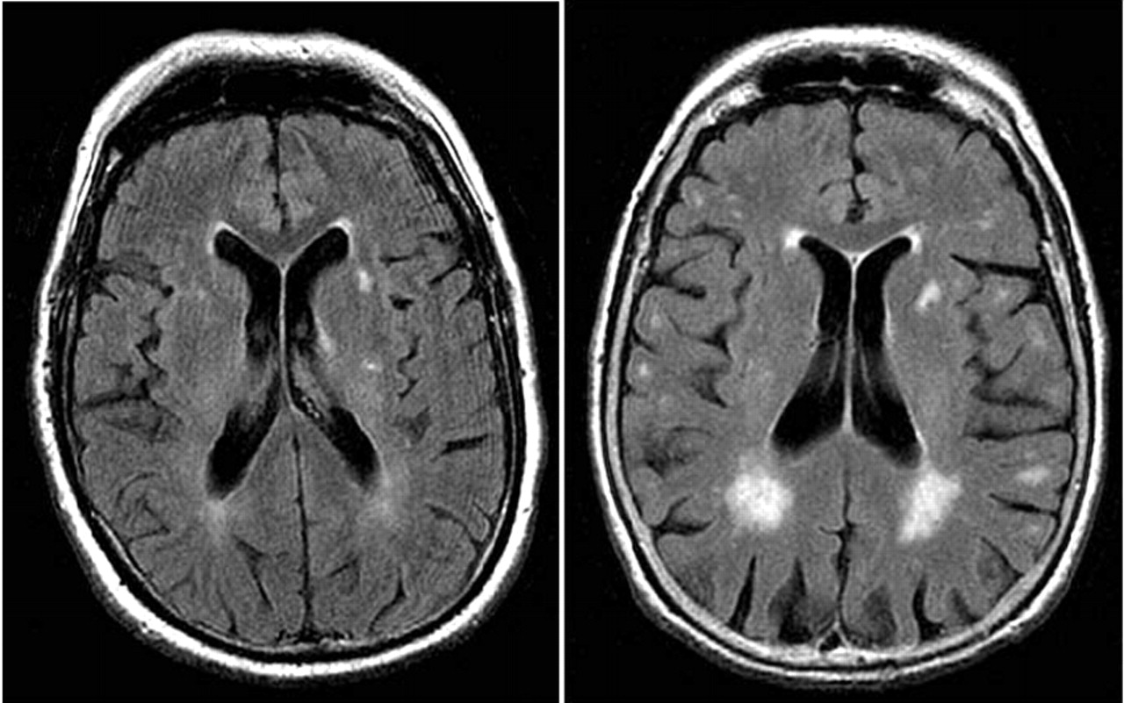
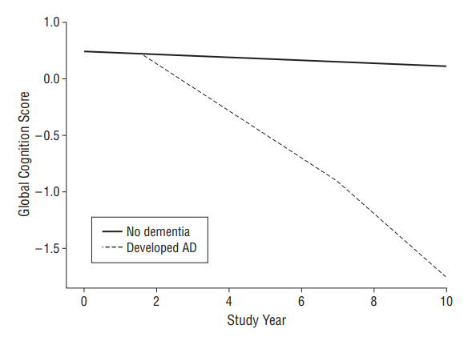
Clinical Needs: Early Detection
Healthy and Alzheimer’s Brain
Global Cognitive Decline
Wilson, Robert S., et al. "Cognitive decline in prodromal Alzheimer disease and mild cognitive impairment." Archives of neurology 68.3 (2011): 351-356.

Slide 5
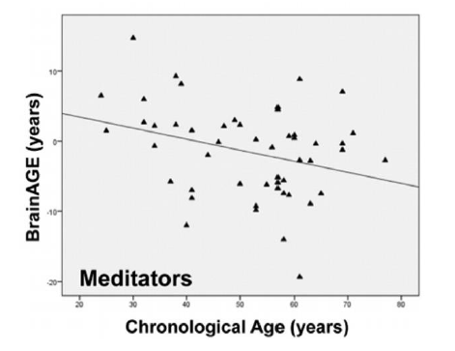
Clinical Needs: Neural Degeneration Process
Brain Injury, Schizophrenia,
HIV, Epilepsy, Down's Syndrome and Diabetes
Meditation, Increased
Levels of Education and Physical Exercise
Brain Ages of Meditation Practitioners
Luders, Eileen, Nicolas Cherbuin, and Christian Gaser. "Estimating brain age using high-resolution pattern recognition: younger brains in long-term meditation practitioners." Neuroimage 134 (2016): 508-513.

Slide 6
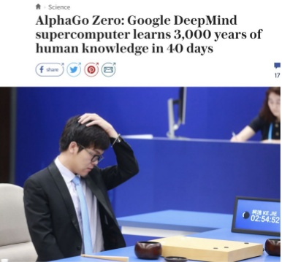

Deep Learning Overview
AI, machine learning, and deep learning
AlphaGo Zero: Reinforcement Learning

Slide 7

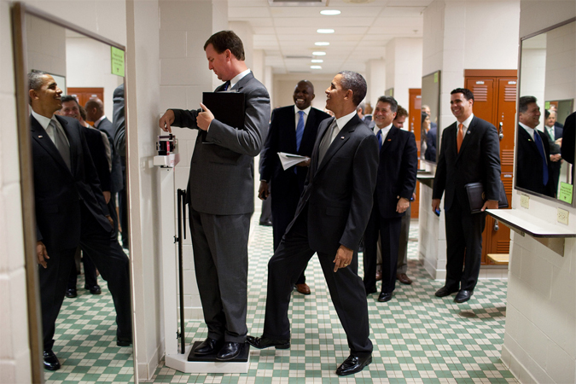


Convolutional Neural Network Overview
What’s
Happening
CNN ConvNet
Credit: Andrej Karpahy
Cat
Dog

Slide 8
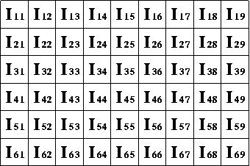

Convolutional Neural Network Overview
Input layer
Output layer
Hidden layer
Neurons
What the computer sees?
[0 1]
[1 0]
numpy array

Slide 9
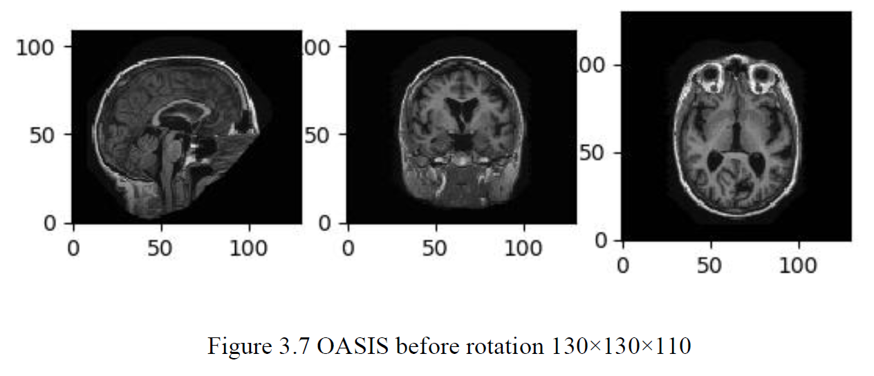
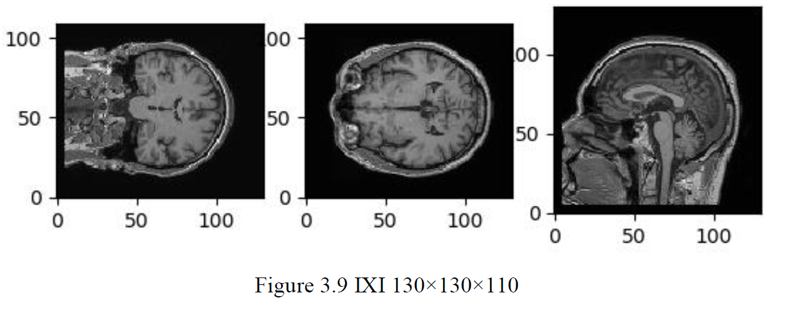
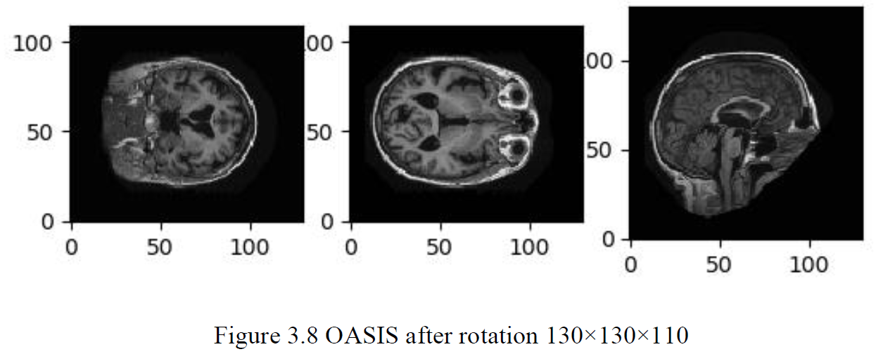
Assumption: healthy individuals’ chronological ages are close to their brain ages
TRAIN
TEST
Estimated Chronological Age
A Scalar

Slide 10
Assumption: healthy individuals’ chronological ages are close to their brain ages
TRAIN
TEST
Brain Age
A Scalar

Slide 11
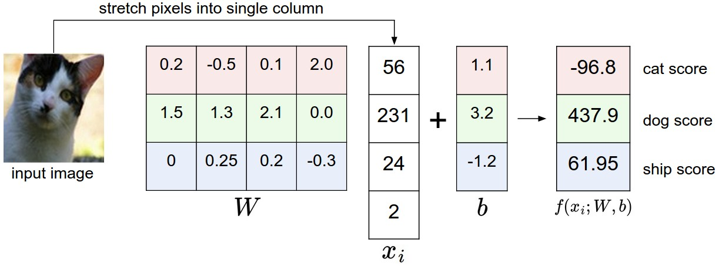
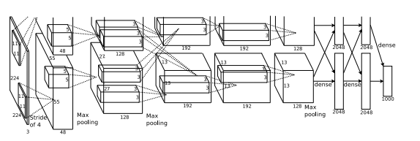
Convolutional Neural Network Overview
Weights
Biases
Forward Propagation
Regression
Image Classification
Convolutional Layer
Max Pooling Layer
Fully-connected Layer
Krizhevsky, A., Sutskever, I., & Hinton, G. E. (2012). Imagenet classification with deep convolutional neural networks. In Advances in neural information processing systems (pp. 1097-1105).
Convolutional Neural Network

Slide 12

Methodology
1. Data Track
Data Acquisition
Data Preprocessing
2. Deep Learning Track
Backpropagation and Cost Function
Activation Function and Weight Initialization
Regularization
CNN Structure

Slide 13
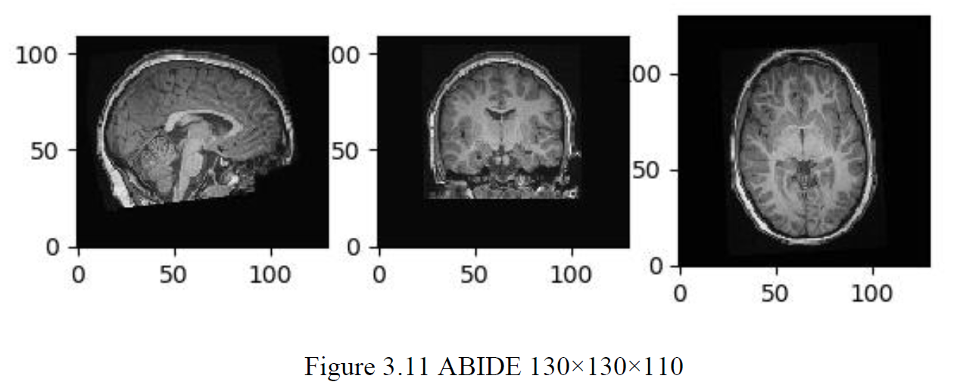
Data Acquisition
Name | Size (N) | Age RANGE | Age Average
OASIS | 316 | 18-96 | 52.4
ABIDE | 574 | 6-56 | 17.0
IXI | 590 | 20-86 | 49.4
ABIDE II | 593 | 6-64 | 14.9
Total | 2072 | 6-96 | 31.0
Excluded Data:
Autism cases
Brain with lesions
Information incomplete

Slide 14
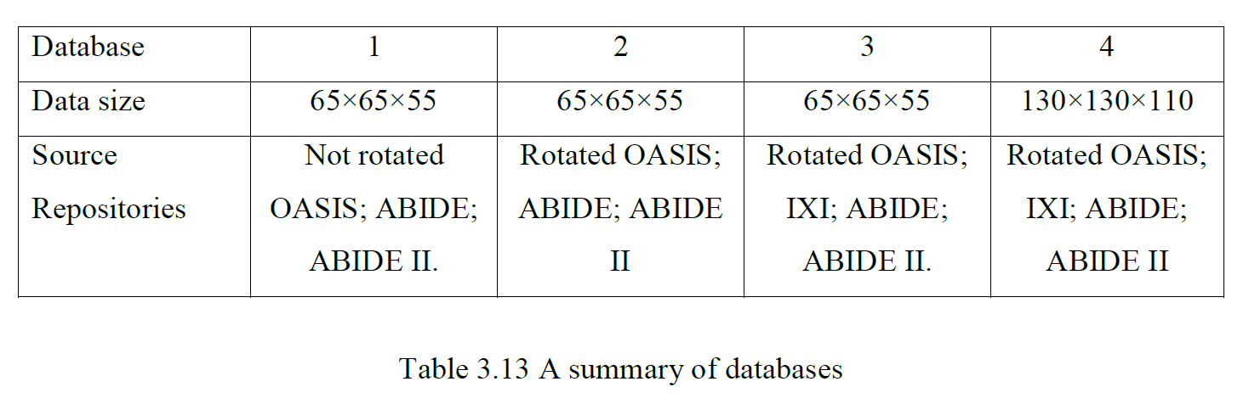
Data Acquisition
Comparing Performance:
Model 1 and Model 2: Image Rotation
Model 2 and Model 3: Non-brain Tissue
Model 1 and Model 4: Sample Size

Slide 15
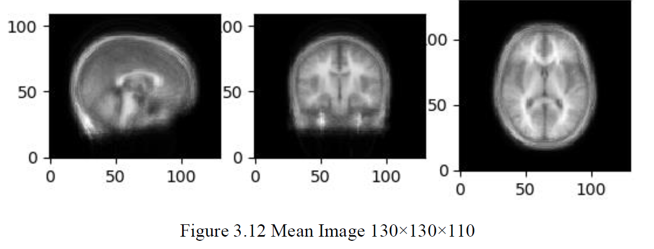
Data Preprocessing
Function Names
def loadData def saveDataset
def print_data_shape def show_slices
def resample def crop_center
def shuffle
def calculate_mean
def combined_preprocess
def conv3d
def maxpool3d
def convolutional_neural_network
def train_neural_network
def rotate_oasis
def shape_oasis
Image resampling
Image cropping or padding
Image shuffling
Subtracting mean
Combining into batches (train and test)

Slide 16
resample.py
crop_center.py
pad.py

Slide 17
A Summary of CNN Concepts
Neuron
Weights
Bias
Activation Function
Sigmoid
ReLU
Softmax
Neural Network
Input/ Output/ Hidden Layer
Forward Propagation
Backpropagation
Cost Function
Gradient Descent
Learning Rate
Batches
Epochs
Dropout
Batch Normalization
Filters
Pooling
Padding
Data Augmentation
SVM
KNN Classifier
Fully Connected Layer
Xavier Initialization
Adam
L-BFGS
Max Pooling
Transfer Learning
VGGNet
GoogleNet
ResNet
Residual Block
Loss Function
Semantic Segmentation
Object Detection
Keras
Tensorflow
PyTorch
Caffe2
Sanity Check
...

Slide 18
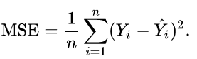
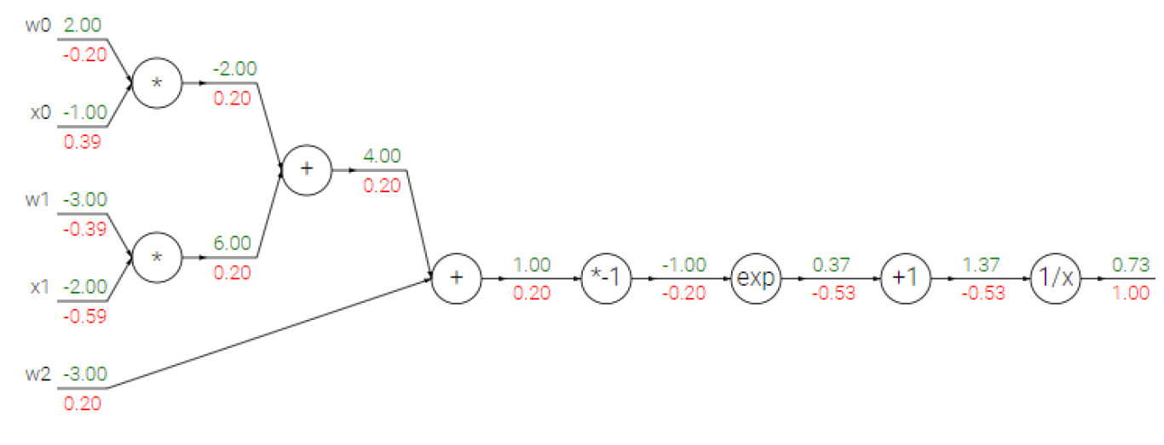
Backpropagation and Cost Function
Our unhappiness with the outcome
Weights are learnable
Chain rule
Local gradient + global gradient
Batch Size
Actual Chronological Age
Estimated Chronological Age
Evaluation:
RMSE
Pearson Correlation Coefficient R
Stanford, CS231N: Convolutional Neural Networks for
Visual Recognition, spring 2018, Stanford.

Slide 19
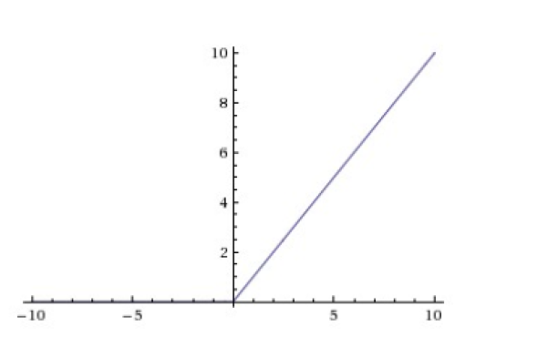

Activation Function and Weights Initialization
Avoid zero-gradient
Avoid gradient explosion
Introduce Non-linearity
Rectified Linear Unit
Xavier Initialization
This project

Slide 20

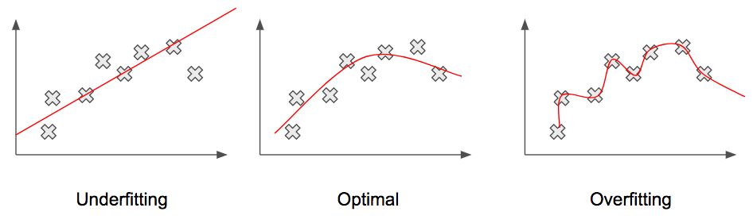
Regularization
Dropout Mechanism
Fitting Patterns
Srivastava, Nitish, et al. "Dropout: A simple way to prevent neural networks from overfitting." The Journal of Machine Learning Research 15.1 (2014): 1929-1958.

Slide 21
CNN Structure
MRI Volume
Estimated Age
Maxpool
Fully-Connected
(train and test)
Conv1
Con2
Conv3
Conv4
Conv5
Layer | Parameters | Activation | Output
Input |  |  | 65×65×55×1
Conv1 | 3×3×3 | ReLu | 65×65×55×8
Maxpool | 2×2×2 |  | 33×33×28×8
Conv2 | 3×3×3 | ReLu | 33×33×28×16
Maxpool | 2×2×2 |  | 17×17×14×16
Conv3 | 3×3×3 | ReLu | 17×17×14×32
Maxpool | 2×2×2 |  | 9×9×7×32
Conv4 | 3×3×3 | ReLu | 9×9×7×64
Maxpool | 2×2×2 |  | 5×5×4×64
Conv5 | 3×3×3 | ReLu | 5×5×4×128
Maxpool | 2×2×2 |  | 3×3×2×128
Fully-connected |  |  | 2304
Regression |  |  | 1

Slide 22

Result
Performance
Image Rotation
Non-brain Tissue
Sample Size

Slide 23
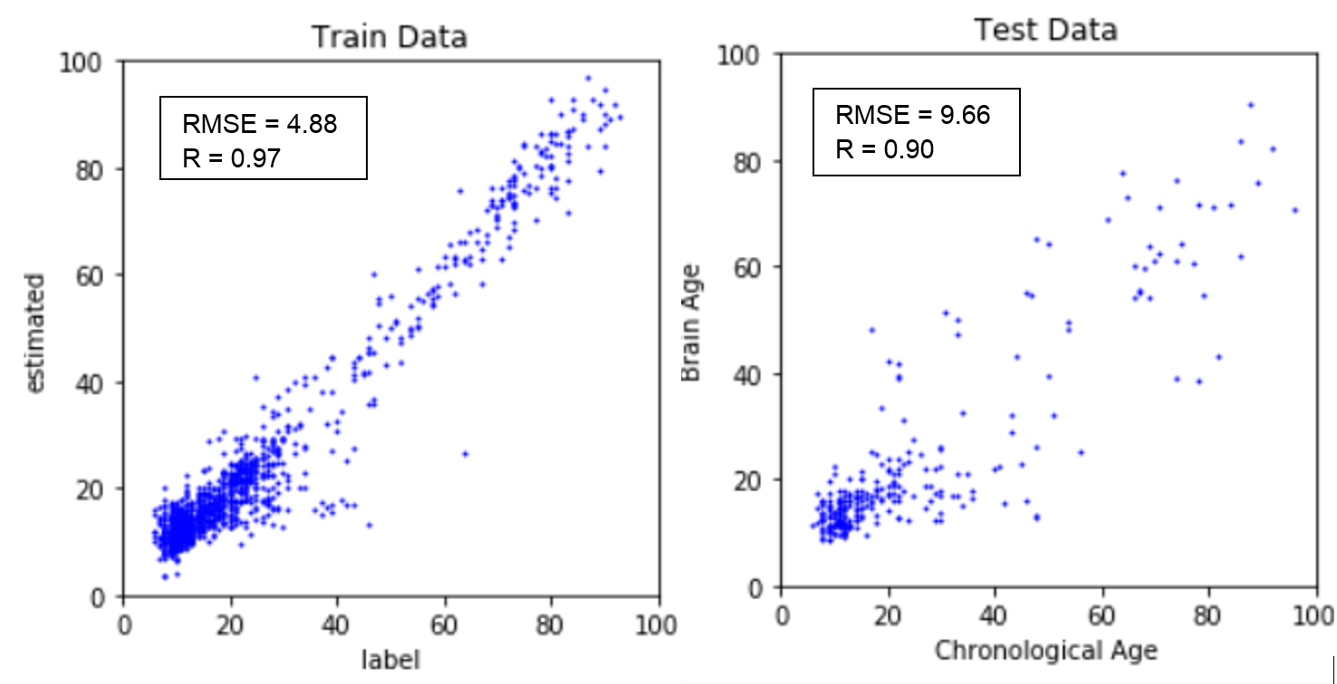
Performance
Database | 1 | 2 | 3 | 4
Optimal Dropout Rate | 0.9 | 0.9 | 0.8 | 0.8
Optimal Learning Rate | 0.00005 | 0.00003 | 0.0001 | 0.00008
Time Efficiency: ~8 hours to train

Slide 24
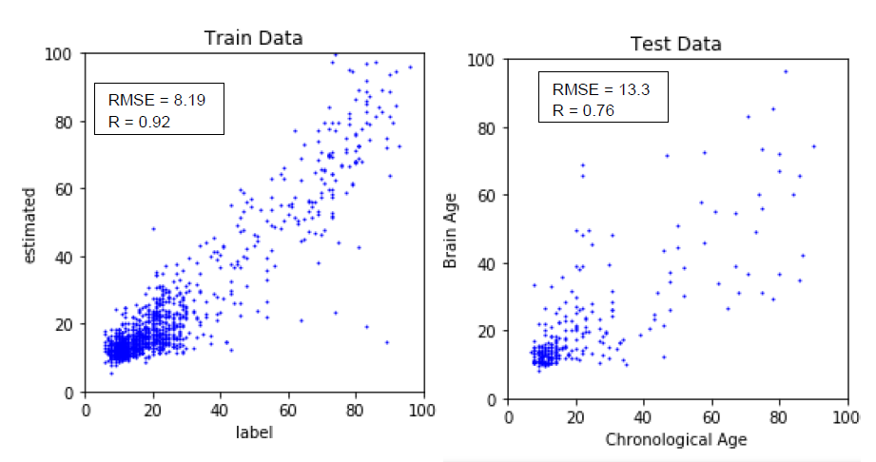
Image Rotation
The model is capable of dealing with images with different orientations
Performance before and after rotation

Slide 25
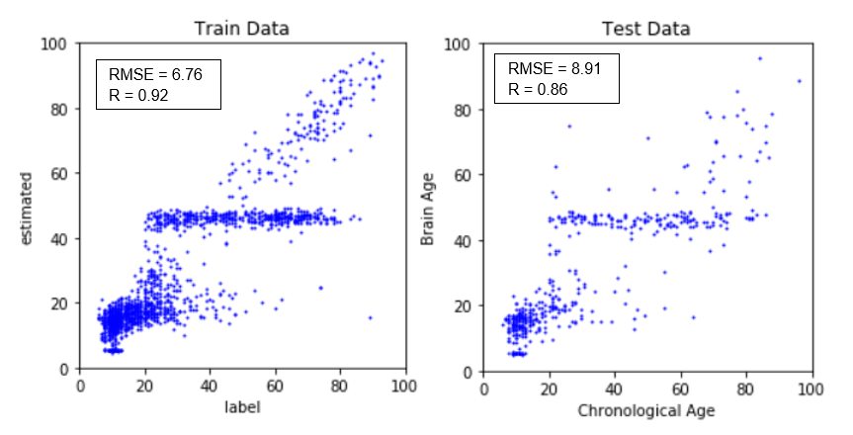
Non-brain tissue
The model performs poorly when non-brain tissues are involved
A wall around average
After including non-brain tissue

Slide 26
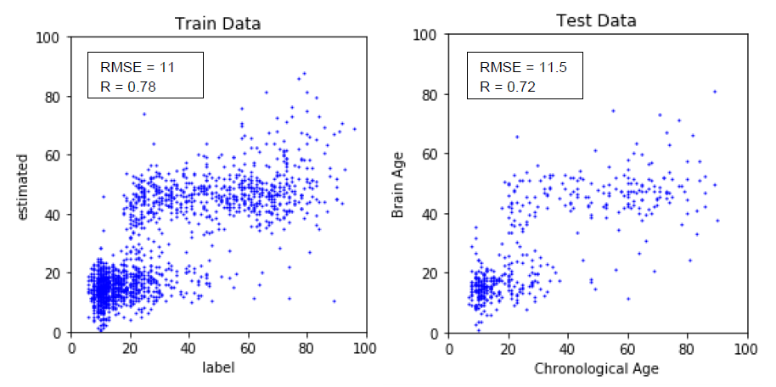
Sample Size
The image quality of 65×65×55 is enough for the sound performance of the model.
Performance using small and large sample size with similar training time

Slide 27

Future Directions
Feature Visualization and Inversion
Disease Detection

Slide 28
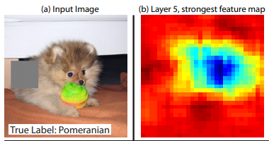
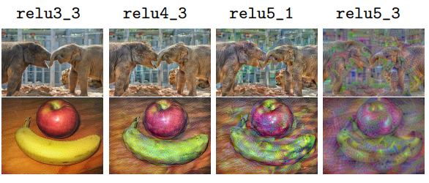
Feature Visualization & Attribution
Visualizing and Understanding:
Delve deeper into the mechanism of brain age and
the importance of brain regions
Visualizing the features by calculating the inexact inverse
Attribution using feature map
Zeiler, Matthew D., and Rob Fergus. "Visualizing and understanding convolutional networks." European conference on computer vision. Springer, Cham, 2014.
Johnson, Justin, Alexandre Alahi, and Li Fei-Fei. "Perceptual losses for real-time style transfer and super-resolution." European Conference on Computer Vision. Springer, Cham, 2016.

Slide 29
Brain Diseases
Name | Size (N) | Age RANGE | Age Average
OASIS | 316 | 18-96 | 52.4
ABIDE | 574 | 6-56 | 17.0
IXI | 590 | 20-86 | 49.4
ABIDE II | 593 | 6-64 | 14.9
Total | 2072 | 6-96 | 31.0
Deviation of brain ages: early detection
The degree of deviation: degree of brain degration

Slide 30
Conclusion
Chronological age of healthy individuals can be predicted from T1-weighted MRI brain images using deep learning with relatively high training efficiency. The resulting brain age estimated by the model using novel data is a valid biomarker. The model is adept at assessing brain images with different orientations but performs poorly when non-brain tissues are not removed. With deep learning visualization and understanding, brain age has the potential to facilitate early detection of brain diseases and to probe the maturation and the aging process of the brain.

Slide 31
Thank You

